Slide 1

Edge-AI Based Distributed Fleet Coordination for Autonomous Mobile Robots
Decentralized Intelligence for Faster, Safer and More Resilient Smart Warehouses
Instead of depending on one central controller, every robot can perceive, decide, communicate and coordinate locally.
Tech Horizon 2.0 • Team / College : Matoshri College Of Engineering And Research Center Nashik

Slide 2
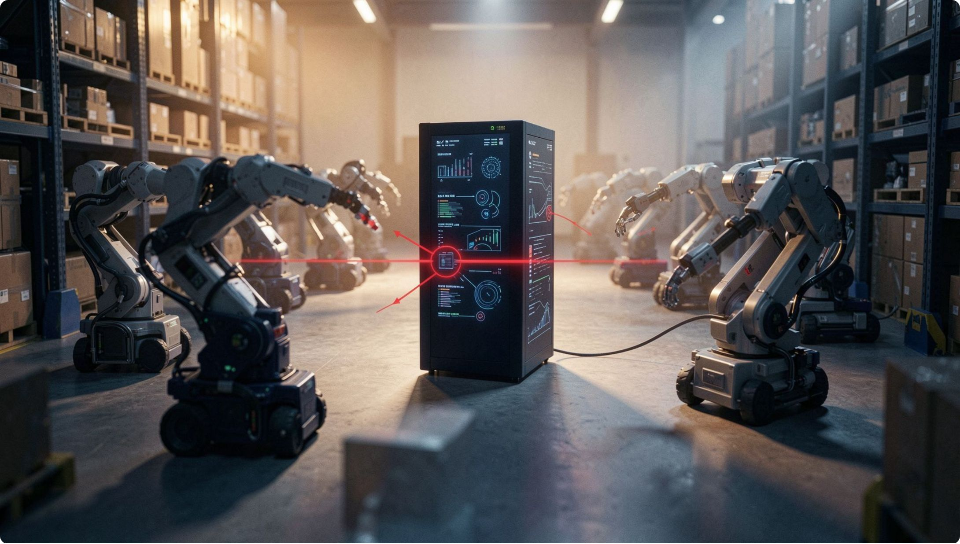

What’s Broken in Today’s Warehouse Robotics?
Centralized fleet challenges
Centralized bottleneck — single decision point
Network latency and Wi‑Fi dead zones
Single point of failure causes fleet pause
Stop‑and‑wait behavior at choke points
Inefficient task allocation; poor local adaptability
Real scenario: Two robots reach a narrow aisle → both wait for central command → congestion and lost time.
As fleets scale, central coordination becomes a time and reliability bottleneck.

Slide 3


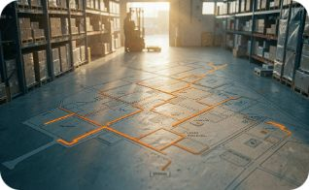

Our Solution: Distributed Edge‑AI Fleet Intelligence
Each AMR: Perceive → Decide → Communicate → Coordinate → Act
Local AI inference
Peer negotiation
Dynamic re‑planning
Models run on-board (Jetson / CPU) for perception and short‑horizon planning.
Robots share position, intent and negotiate conflicts locally.
Local re-routing and task reallocation without central approval.
Central server remains optional for monitoring, analytics and high‑level management.

Slide 4

From Warehouse Event to Autonomous Action
Perceive
Edge AI
LiDAR, camera, IMU sense environment.
Local detection and short‑term prediction.
Local Decision
Coordination
Plan path and avoid collisions locally.
P2P share position, intent, priority.
Example: Robot A detects blocked aisle → broadcasts obstacle → Robot B receives → both re‑plan locally → fleet proceeds.

Slide 5
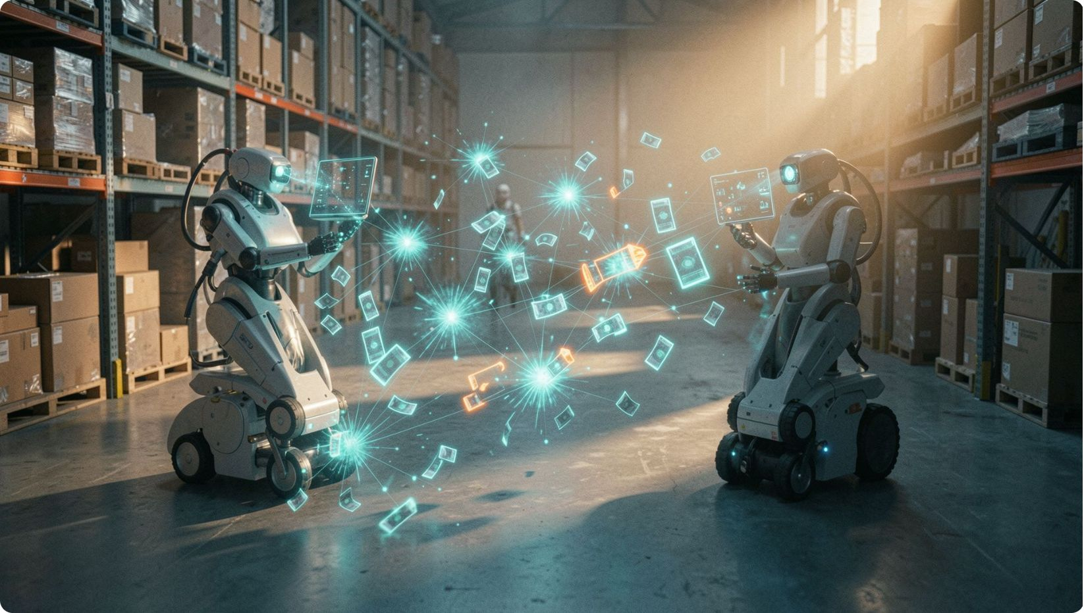
How Do Robots Coordinate Without a Central Controller?
Peer Broadcasts (periodic)
Position • Velocity
Current task • Planned path
Intended direction • Obstacle info
Priority level
Conflict resolution (local)
Detect path overlap
Compare priority / ETA
Negotiate: adjust speed or replan
Confirm and continue
Key: distributed decisions and deadlock prevention — robots negotiate instead of simply stopping.

Slide 6
Intelligence Running at the Edge
Perception
Localization
Path Planning
Multi‑Agent Coordination
Lightweight detection (YOLO variants), semantic cues, LiDAR-based obstacle sensing.
SLAM + IMU + odometry fusion for robust pose estimate.
A* / D* Lite with dynamic replanning and velocity profiling for safety.
Priority negotiation, distributed task allocation, conflict detection.
Edge targets: NVIDIA Jetson-class, industrial ARM boards, or equivalent — optimized models for latency and power.

Slide 7
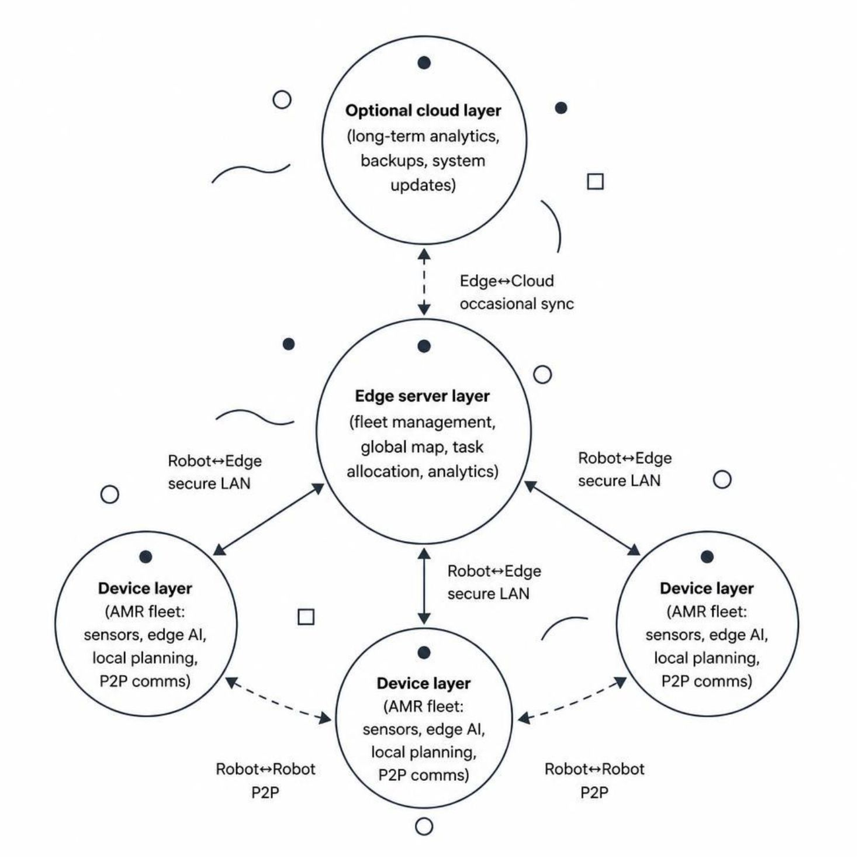
End‑to‑End System Architecture
Device Layer
Edge inference, local planning, P2P low‑latency comms
Resilient: continues if server unavailable
Edge Server Layer
Global map, model management, monitoring
Optional central task allocation and analytics
Optional Cloud
Long‑term analytics, dashboards, OTA updates
Protocols: ROS2 / DDS, WebRTC DataChannel, gRPC; Networks: Wi‑Fi6 / 5G / TSN where available.

Slide 8
Why Distributed Edge‑AI?
Centralized Approach | Distributed Edge‑AI
Central bottleneck; single point of failure | Local decision making; no single decision bottleneck
High dependency on network; greater latency | Low‑latency local response; P2P coordination
Poor resilience during outages | Continues operating during network disruption
Limited local autonomy | Scales across larger fleets with peer negotiation
Three priority outcomes: LOWER LATENCY • HIGHER RESILIENCE • BETTER FLEET UTILIZATION

Slide 9
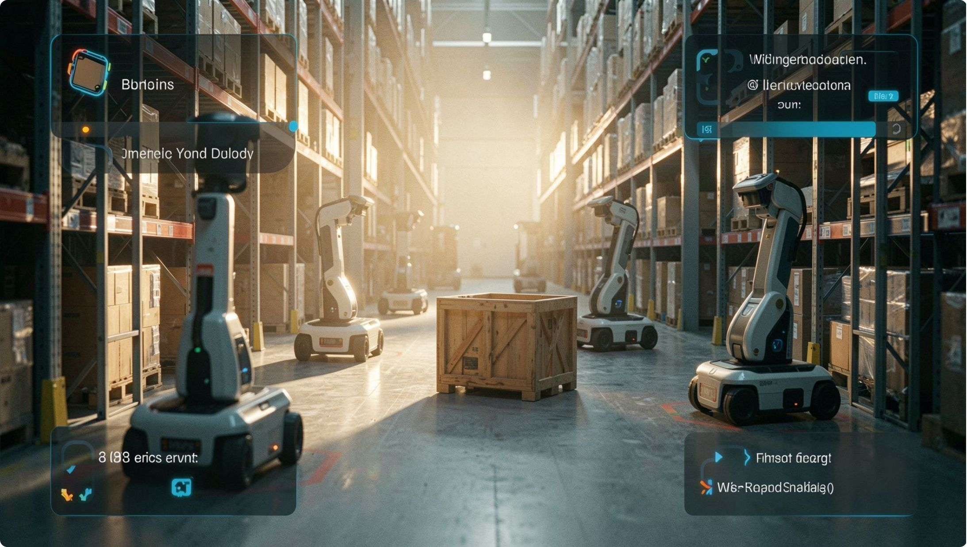
Demo Plan & Success Criteria
Demo scenario
3–5 AMRs, pickup/drop zones, narrow aisles
Overlapping tasks and a choke point
Robots detect conflict, negotiate priority, replan
Dynamic obstacle blocks aisle → broadcast → fleet reroutes
Simulated network disruption to validate local continuity
Success metrics (TARGET / VALIDATION)
Zero inter‑robot collisions
Successful conflict resolution and dynamic re‑routing
Reduced waiting time and total task completion time
Continued operation during network disruption
Target: ≥20% reduction in total task completion time vs basic stop‑and‑wait strategy (expected / to be validated)

Slide 10
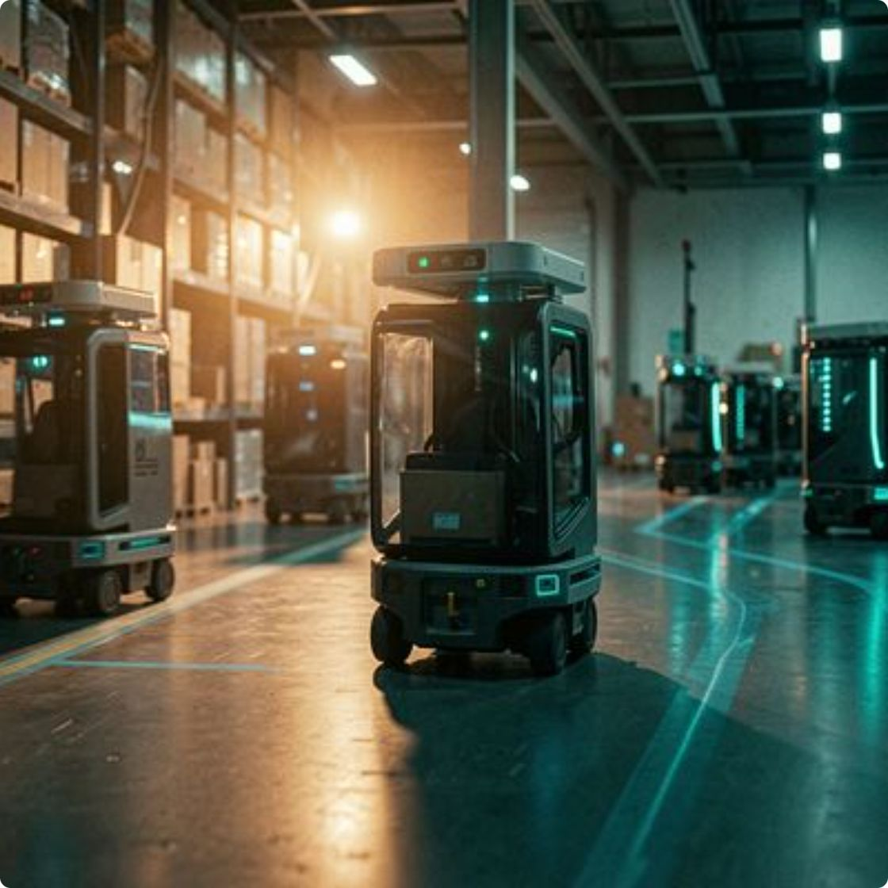
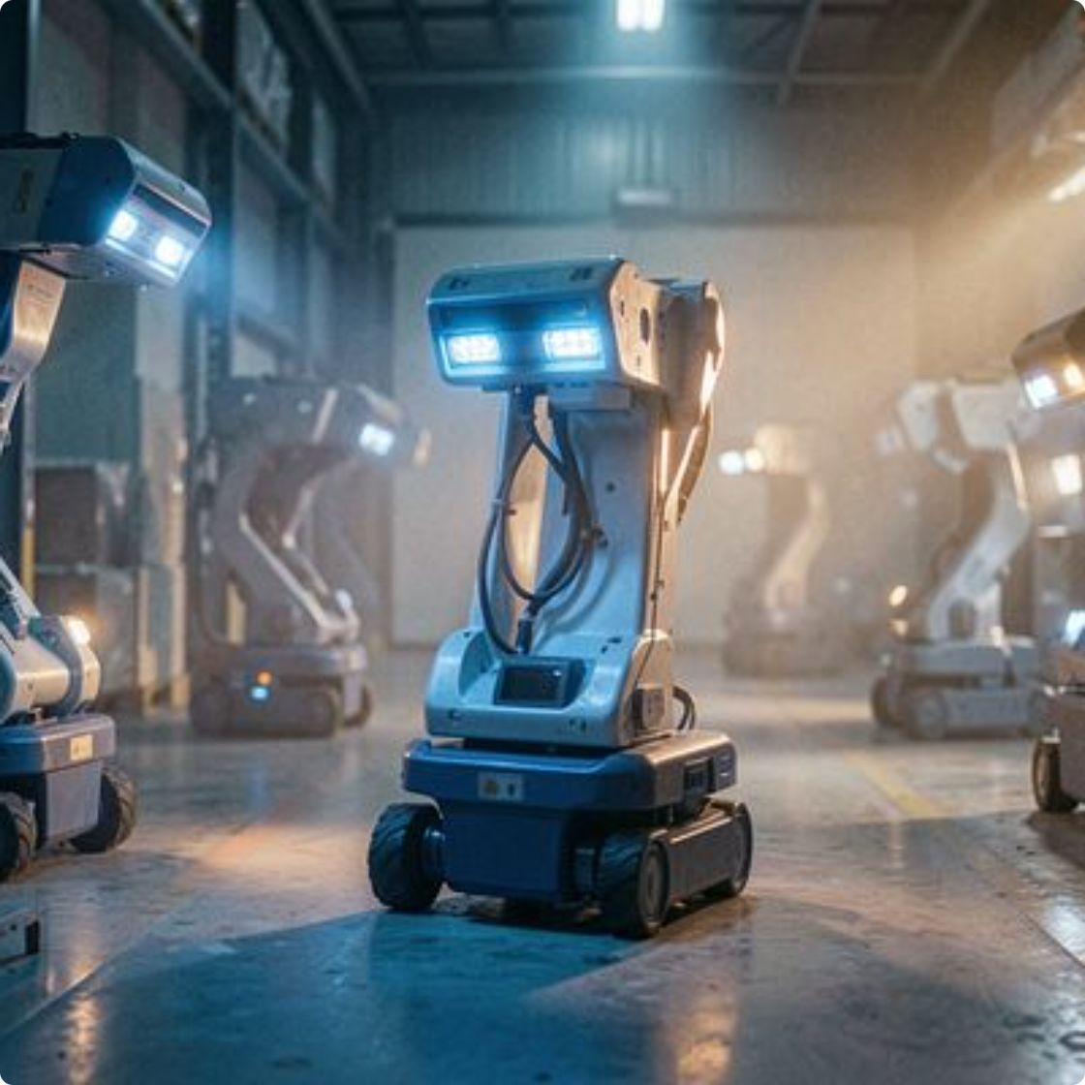
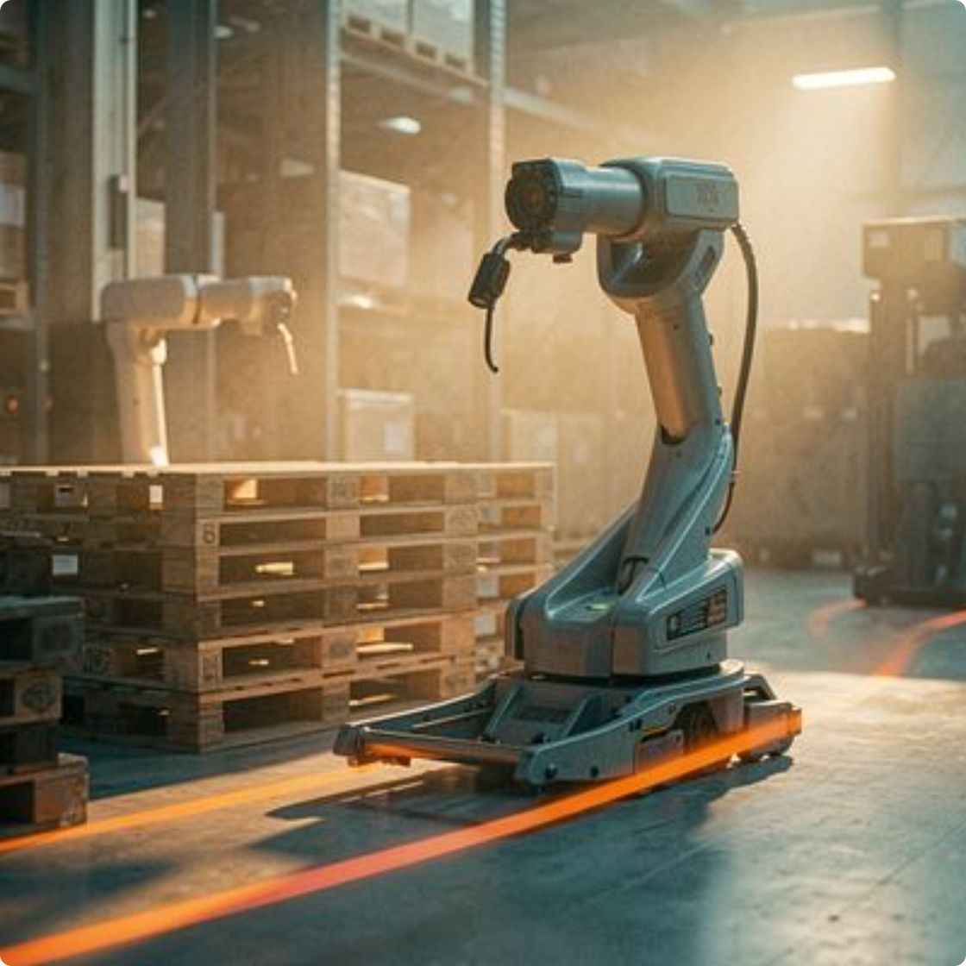



From Smart Robots to an Autonomous Warehouse Fleet
Real benefits
Roadmap
Final pitch
Real‑time coordination • Reduced congestion • Better fleet utilization • Resilient operation
Federated learning • Digital twin • Multi‑warehouse coordination • Human‑robot collaboration
Traditional fleets wait for instructions. Our fleet perceives, negotiates, adapts and acts.
Distributed by design. Intelligent at the edge. Autonomous as a fleet.
Contact: Tech Horizon 2.0 Team • Demo ready for Tech Horizon 2.0 Hyderabad

